Slide 1
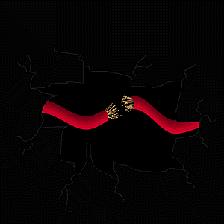
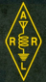
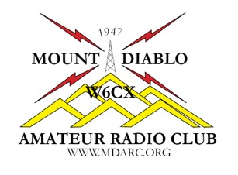
Chapter 3
Electricity, Components, and Circuits
Name, Callsign
Discussion Leader
American Radio Relay League

Slide 2
Brief Review of Chapter 6 Exam Questions
Which Q signal indicates that you are receiving interference from other stations?
QRM
QRN
QTH
QSB
Notes:
Correct Answer: (D) Current Page 3-1

Slide 3
Brief Review of Chapter 6 Exam Questions
Which Q signal indicates that you are receiving interference from other stations?
QRM
T2B10 Page 6-7
Notes:
Correct Answer: (D) Current Page 3-1

Slide 4
Brief Review of Chapter 6 Exam Questions
What is an appropriate way to call another station on a repeater if you know the other station's call sign?
Say break, break then say the station's call sign
Say the station's call sign then identify with your call sign
Say CQ three times then the other station's call sign
Wait for the station to call CQ then answer it
Notes:
Correct Answer: (D) Current Page 3-1

Slide 5
Brief Review of Chapter 6 Exam Questions
What is an appropriate way to call another station on a repeater if you know the other station's call sign?
Say the station's call sign then identify with your call sign
T2A04 Page 6-4
Notes:
Correct Answer: (D) Current Page 3-1

Slide 6
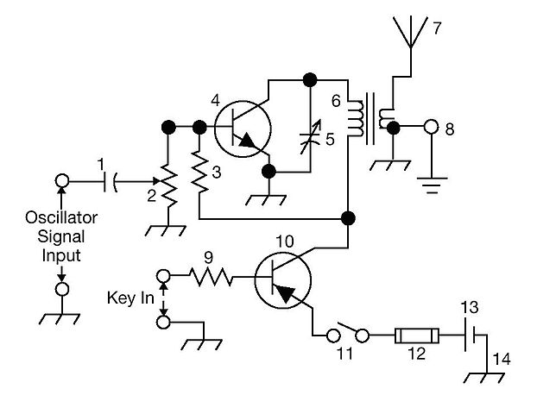
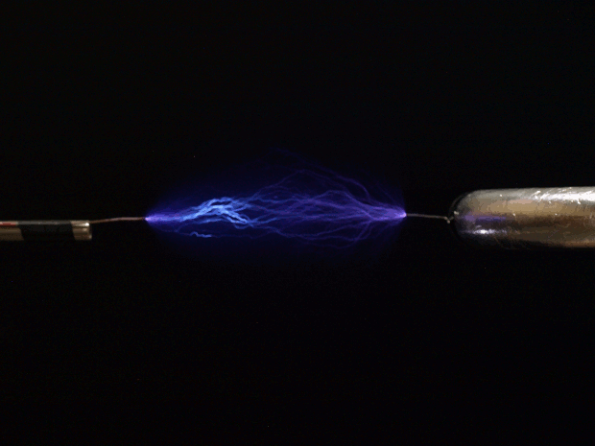
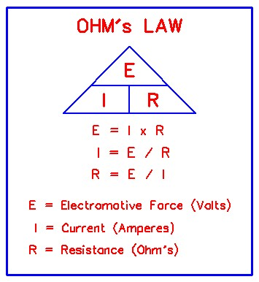
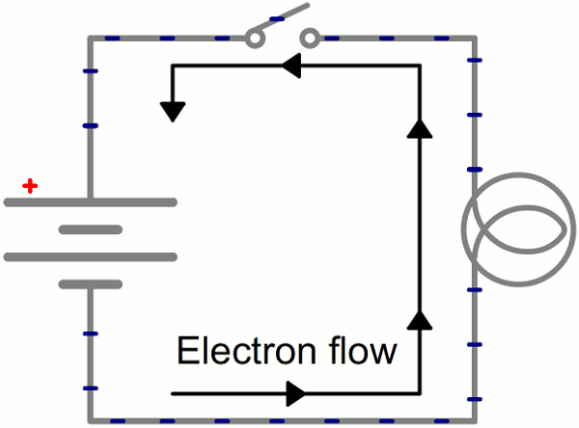
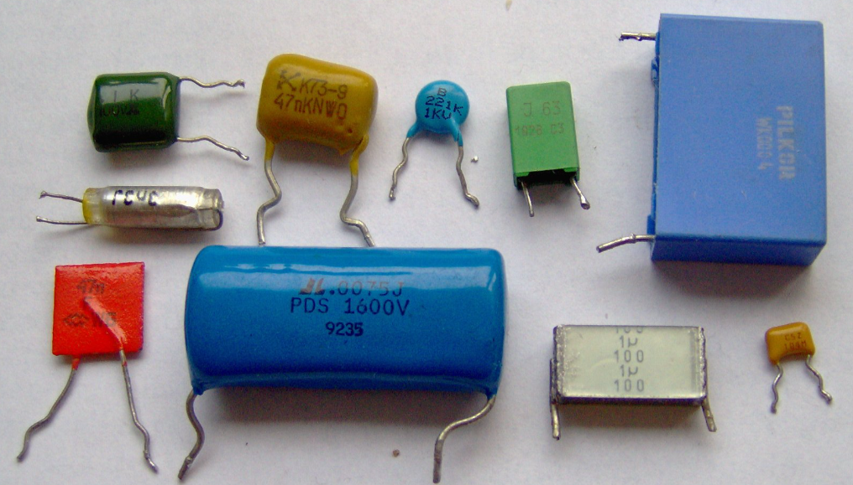
Chapter 3 Electricity, Components, and Circuits
Last week we learned about communicating with other hams.
Today we will be learning about electrical properties, hardware and other fun stuff that makes this possible.

Slide 7
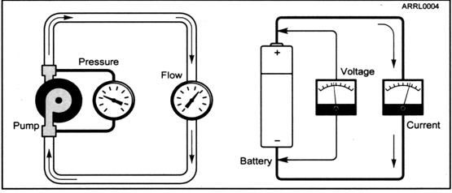
Chapter 3 3.1 Electricity
Voltage and Current
Water Flow Analogy
Electron Flow
Voltage acts like pressure in a water pipe.
Current acts like water flow in a pipe.
Figure 3.2

Slide 8
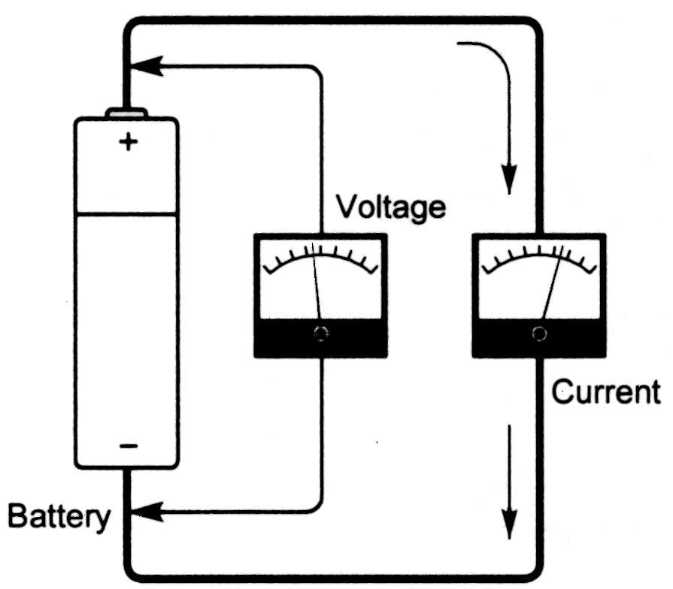
Chapter 3 3.1 Electricity
Current
Electric current ( I ) is measured in AMPS (A).
Current is measured with an AMMETER.
Figure 3.2 detail

Slide 9
Chapter 3 3.1 Electricity
Voltage
Voltage, E, electromotive force (EMF), is also called electric potential and is measured in Volts (V) using a Voltmeter.
Figure 3.1 detail

Slide 10
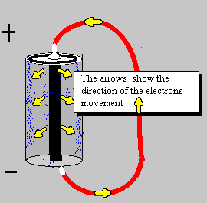
Chapter 3 3.1 Electricity
Polarity
Polarity is between POSITIVE (+) and NEGATIVE (-).
Because of historical reasons, we depict electrons flowing from positive to negative, but in actuality electrons always flow from negative to positive.
This is actual flow of electrons

Slide 11
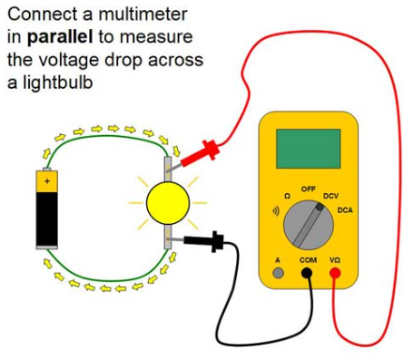
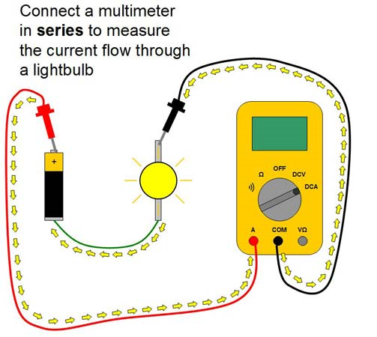
Chapter 3 3.1 Electricity
Measuring Voltage and Current
Connect a multimeter in parallel to measure the voltage drop across a lightbulb.
Connect a multimeter in series to measure the current flow through a lightbulb.

Slide 12
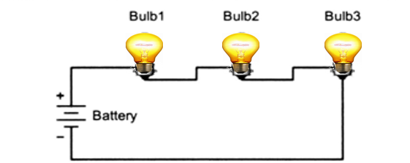
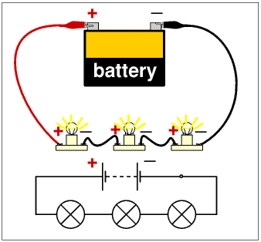
Chapter 3 3.1 Electricity
Circuits
A circuit is any path through which current can flow.
Electrons always flow in a circular path. If all components in a circuit are in the same path, it is a SERIES circuit.

Slide 13
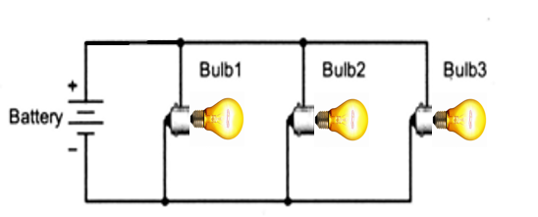
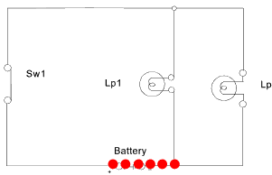
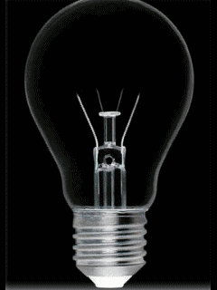
Chapter 3 3.1 Electricity
Circuits
Lp1
Sw1
Lp1
Battery
Figure 3.2 Page 3-2
If components are connected so they all see the same voltage, it is a PARALLEL circuit .

Slide 14
Chapter 3 3.1 Electricity
Circuits
Figure 3.2 Page 3-2
If components are connected so they all see the same voltage, it is a PARALLEL circuit .

Slide 15
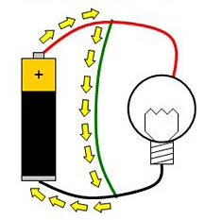
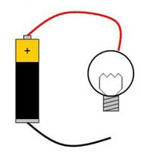
Chapter 3 3.1 Electricity
Circuits
A short circuit is a direct connect between two points in a circuit
An open circuit is made by breaking a current path in a circuit

Slide 16
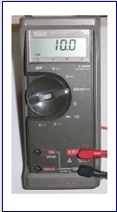
Chapter 3 3.1 Electricity
Meters
Modern meters usually combine several measurements in one device called a MULTIMETER (multifunction meter).
Voltage, Current, and Resistance can ALL be measured with a multimeter.
Flexibility in measurement means one has to be careful to use the multimeter with the right settings.
Attempting to measure a voltage when the meter is set to measure a resistance is a common way to damage the meter.
Follow the user manual!!!

Slide 17
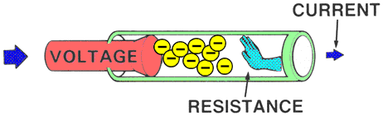
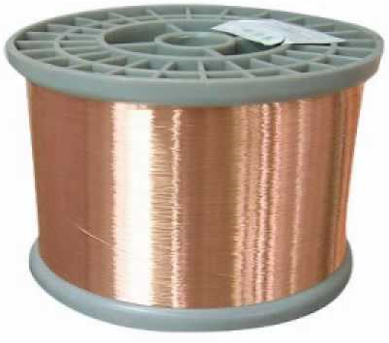
Chapter 3 3.1 Electricity
Resistance and Conductors
Impeding the flow of electrons is called RESISTANCE, (Omega Ω), measured by an OHMMETER.
Materials with an easy flow of electrons are called CONDUCTORS. Metals like copper are good conductors. So is salt water and since humans are about as salty as sea water, we are also good conductors!

Slide 18
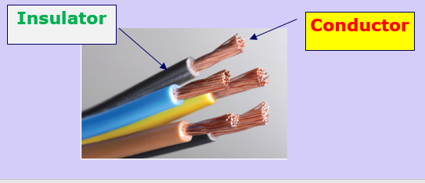
Chapter 3 3.1 Electricity
Insulators
Materials that resist or prevent the flow of electrons are called INSULATORS.
Glass, dry wood, paper, rubber, most plastics and other non-metals are good insulators.

Slide 19
Chapter 3 3.1 Electricity
Ohm’s Law
George Ohm, in the 1800s, discovered that resistance, voltage, and current are proportional.
Ohm’s Law states that …………………….
Current (I) is directly proportional to voltage (E).
Simply stated:
As voltage increases, current increases.
2) Current (I) is inversely proportional to resistance (R). Simply stated:
As resistance increases, current decreases.

Slide 20
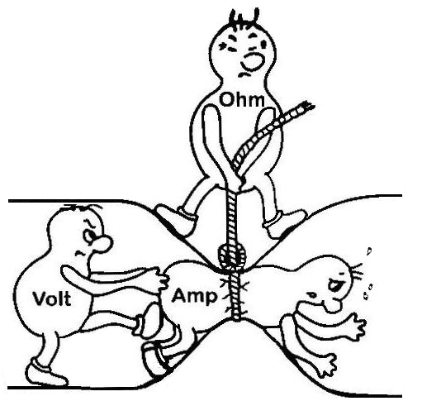
Chapter 3 3.1 Electricity
Ohm’s Law
This can also be stated as………
“The more a material resists the flow of electrons, the lower the current will be in response to voltage across the material.”
Page 3-4
This equation expresses the relationship between current, voltage and resistance………….
I=E/R
I=current in amperes, E=voltage in volts, R=resistance in ohms

Slide 21
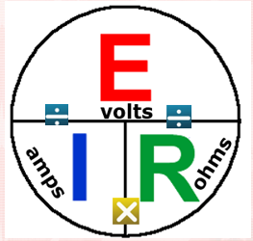
Chapter 3 3.1 Electricity
Ohm’s Law
Don’t let the math scare you!!!!!
E = I x R
I = E / R
R = E / I
Modification of Figure 3.5A

Slide 22
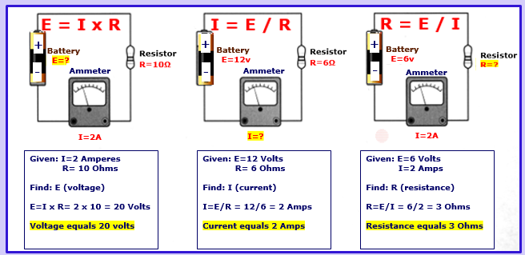
Chapter 3 3.1 Electricity
Ohm’s Law: Examples
Figure 3.5 Page 3-4

Slide 23
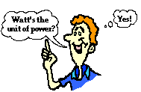
Chapter 3 3.1 Electricity
Ohm’s Law and Power Equations
POWER (P), measured in WATTS (W), is the rate at which electrical energy is used.
The quantity of power consumed by a circuit is called the LOAD.
POWER is proportional with VOLTAGE and CURRENT
P = E x I
I = P / E
E = P / I

Slide 24
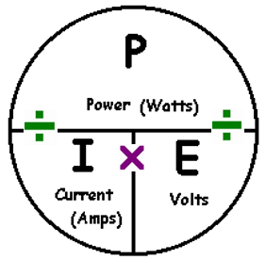
Chapter 3 3.1 Electricity
Ohm’s Law and Power Equations
P = I x E
I = P / E
E = P / I
Modification of Figure 3.5B

Slide 25
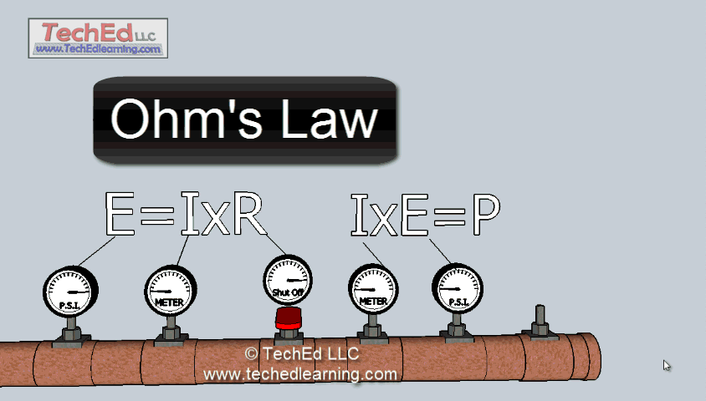
Chapter 3 3.1 Electricity
Ohm’s Law and Power Equations
A water analogy showing the relationship between Ohm’s Law and Power.

Slide 26
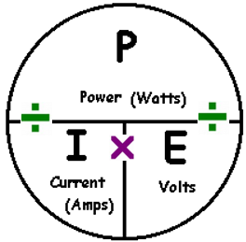
Chapter 3 3.1 Electricity
Power Equations: Examples
How much power is being used when the applied voltage is 14.9 volts DC and the current is 15 amperes?
P = (E x I) = (14.9 V x 15 A) = 223.5 W (watts)
What is the voltage in a circuit if a 125 watt load draws 8 amps?
E = (P / I) = (125 W / 8 A) = 15.6 V (volts)
How many amperes are flowing in a circuit when the applied voltage is 3 volts and the load is 100 watts?
I = (P / E) = (100 W / 3 V) = 33.3 A (amps)

Slide 27
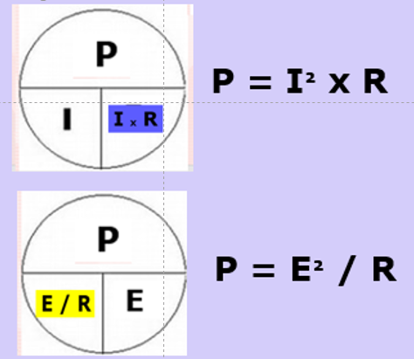

Chapter 3 3.1 Electricity
Power Equations
Because Ohm’s Law links voltage, current and resistance, E and I can be replaced in the power equation with their equivalents.

Slide 28
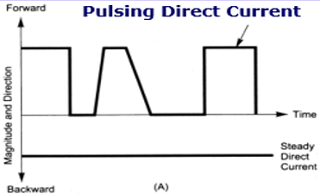
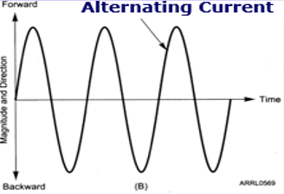
Chapter 3 3.1 Electricity
AC and DC
Current that flows in one direction all the time is called DIRECT CURRENT, abbreviated DC.
Current that reverses direction regularly is called ALTERNATING CURRENT, abbreviated AC.
Figure 3.1

Slide 29
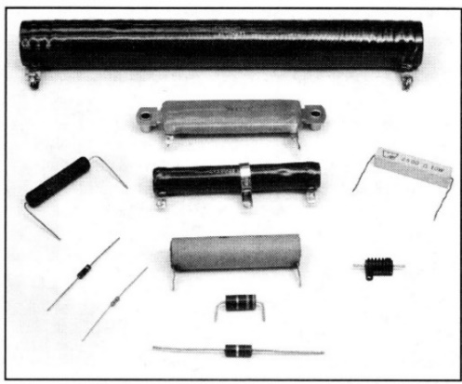
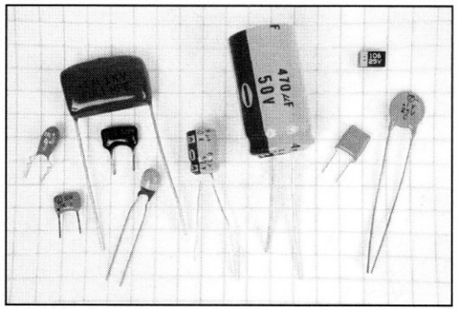
Chapter 3 3.2 Components and Units
Basic Components
Resistors oppose the flow of current in circuits.
Capacitors store electric energy in the electric field between two conducting surfaces called ELECTRODES, separated by an insulator called a DIELECTRIC.
Figure 3.7
Storing energy in an electric field is called CAPACITANCE, and is measured in FARADS (F).
Figure 3.8

Slide 30
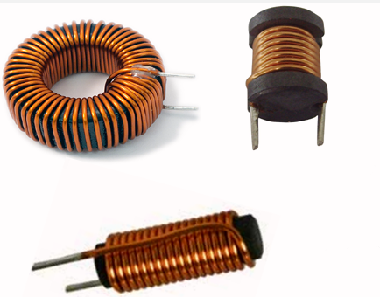
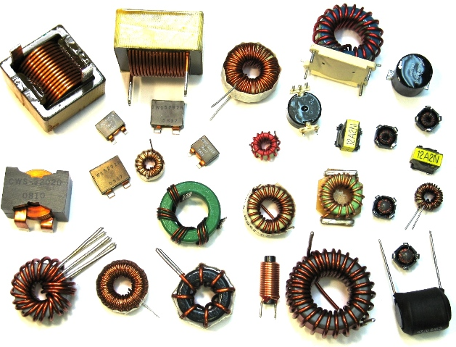
Chapter 3 3.2 Components and Units
Basic Components
Inductors store energy in a MAGNETIC FIELD created by energy flowing through a wire.
Storing energy in a magnetic field is called INDUCTANCE and is measured in HENRYS (H).
Inductors are made from WIRE wound in a COIL, sometimes around a magnetic CORE.

Slide 31
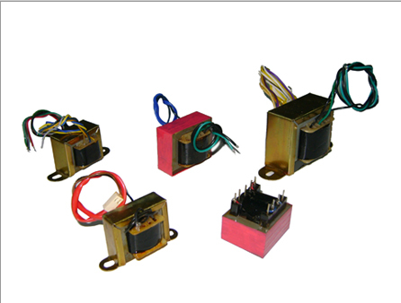
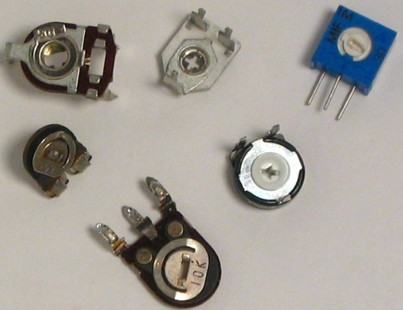
Chapter 3 3.2 Components and Units
Basic Components
TRANSFORMERS are made from two inductors that share a stored magnetic field. This arrangement allows energy to be transferred from one inductor to the other, while changing the combination of AC voltage and current.
Resistors can be made with values that can be varied. A variable resistor is often called a POTENTIOMETER, and is often used to control a voltage, such as in a volume control.

Slide 32
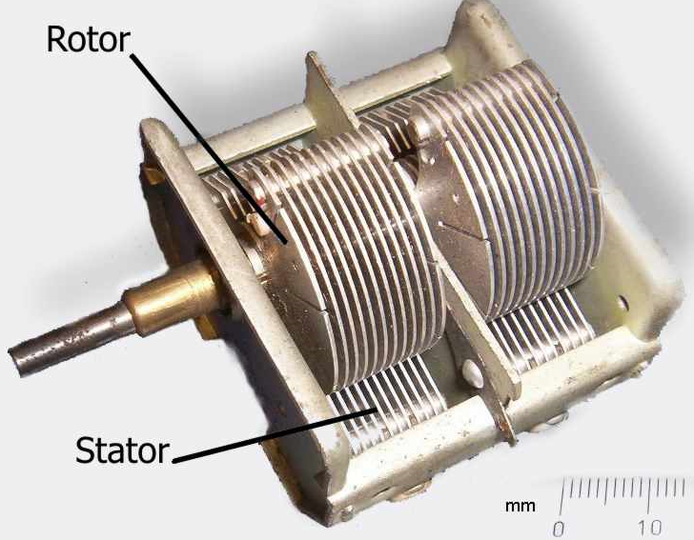
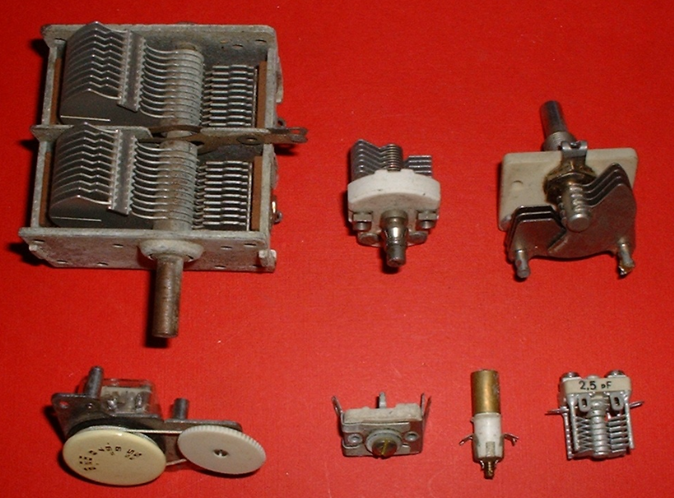
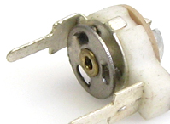
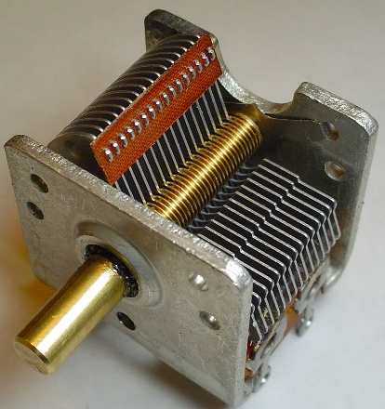
Chapter 3 3.2 Components and Units
Basic Components
Variable Capacitors are built so that its two electrodes can move, and change capacitance.
A change in tuning frequency is usually done with a variable capacitor.

Slide 33
Chapter 3 3.2 Components and Units
Reactance and Impedance
In resistors, current and voltage always follow exactly Ohm’s law and stay IN PHASE, whether the current is AC or DC.
In capacitors and inductors, AC current and voltage become altered so that their values shift with time. The amount of shift is measured as a PHASE DIFFERENCE.

Slide 34
Chapter 3 3.2 Components and Units
Reactance and Impedance
Capacitors resist a change in voltage.
Inductors resist a change in current.
These resistances are measured in OHMS, but are called either CAPACITIVE REACTANCE (for capacitors) or INDUCTIVE REACTANCE (for inductors), and labeled ( X ).

Slide 35
Chapter 3 3.2 Components and Units
Reactance and Impedance
Various combinations of resistors, capacitors, and inductors in AC circuits will have combinations of resistance and reactance, measured in OHMS but called IMPEDANCE, and labeled ( Z ).
Z (impedance) is a general term used to mean a circuit’s opposition to AC current flow.

Slide 36
Chapter 3 3.2 Components and Units
Resonance
Since capacitive reactance and inductive reactance depend on the FREQUENCY of the AC current, the two out-of-phase reactances, at some specific frequency, will equal each other and cancel out, bringing current and voltage back into step with each other.
This is called RESONANCE, and the frequency it happens at is called the RESONANT FREQUENCY.

Slide 37
Chapter 3 3.2 Components and Units
Resonance
Circuits that have at least one resonant frequency are called RESONANT CIRCUITS or TUNED CIRCUITS.
A tuned circuit acts as a filter, passing or blocking AC signals at its resonant frequency.
Tuned circuits are very important in radio because they make it possible to send and receive signals at specific frequencies.

Slide 38
Chapter 3 3.2 Components and Units
Diodes, Transistors and Integrated Circuits
SEMICONDUCTORS, solid pieces of germanium, silicon or other exotic crystals, have almost completely replaced the use of vacuum tubes in modern day equipment.
A method of making solid state diodes was discovered at Bell Labs in 1940.
Transistors were invented at the same facility in 1948.

Slide 39
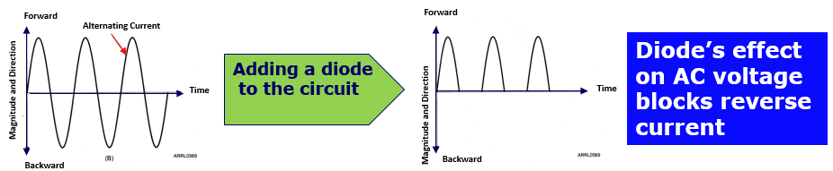
Chapter 3 3.2 Components and Units
Diodes, Transistors and Integrated Circuits
A diode allows DC current to flow in one direction, but not in the opposite direction.
When an AC voltage is applied to a diode, the result is a pulsing, unidirectional current, because the reverse current is selectively blocked.
Heavy duty diodes are called RECTIFIERS.

Slide 40
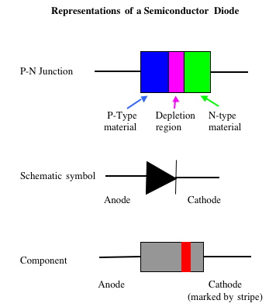
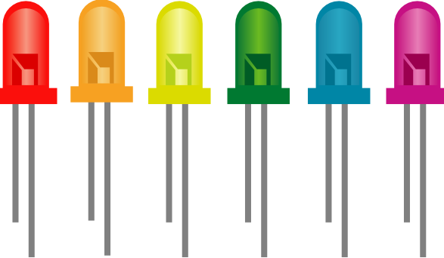
Chapter 3 3.2 Components and Units
Diodes, Transistors and Integrated Circuits
A diode is made of a junction of P-type semiconductor (the ANODE) and N-type semiconductor (the CATHODE).
The CATHODE is usually identified by a stripe on the body of the diode.
Light Emitting Diodes (LEDs) give off light when current flows through them. The kind of material the LED is made from determines the color of the light emitted.
LEDs are often used as visual indicators.

Slide 41
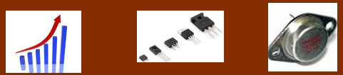
Chapter 3 3.2 Components and Units
Diodes, Transistors and Integrated Circuits
Transistors are semiconductor devices that allow small changes in current or voltage to control much larger currents and voltages.
With the right kind of external circuit and a source of power, transistors can amplify or switch voltages and currents.
Using small signals to control larger signals is called GAIN.

Slide 42
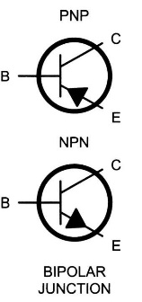
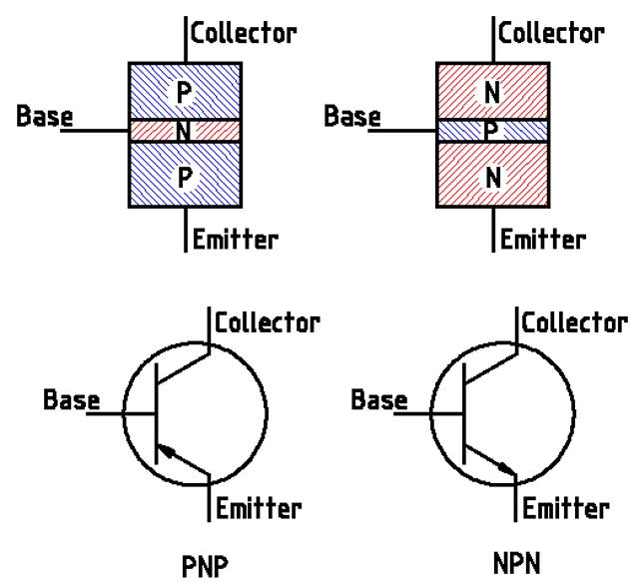
Chapter 3 3.2 Components and Units
Diodes, Transistors and Integrated Circuits
Types of Transistors
Bipolar Junction Transistor (BJT)
BJTs are made from alternating layers of
N-type and P-type material.
The electrodes in a BJT are called EMITTER, BASE, AND COLLECTOR.

Slide 43


Chapter 3 3.2 Components and Units
Diodes, Transistors and Integrated Circuits
Types of Transistors
FIELD EFFECT TRANSISTORS (FET)
FETs are made from a channel of N-type or P-type material. The ends of the channel are called the SOURCE and DRAIN electrodes.
The GATE electrode is used to control current flow through the channel.

Slide 44

Chapter 3 3.2 Components and Units
Diodes, Transistors and Integrated Circuits
Many solid state components connected together and packaged as a single unit are called an INTEGRATED CIRCUIT (IC).
ICs range in complexity from just a few diodes, to many thousands of transistors, in microprocessors and signal processing chips.
Jack Kilby at Texas Instruments built the first Integrated Circuit in 1959.

Slide 45


Chapter 3 3.2 Components and Units
Protective Components
Fuses
Fuses interrupt current overloads by melting a short length of metal.
When the fuse “blows” (link melts), the circuit is interrupted and the power is removed from circuits supplied by the fuse.
Fuses cannot be reused. Once a fuse blows, it must be replaced.
NEVER substitute a larger value fuse when replacing one that has blown. A fire hazard can result.

Slide 46


Chapter 3 3.2 Components and Units
Protective Components
Circuit Breakers
Like fuses, circuit breakers interrupt current overloads by “tripping” rather than by melting a short length of wire.
“Tripping” opens or “breaks” the circuit so that the power is removed from circuit.
Unlike fuses, circuit breakers can be reused by resetting them.
Always replace a circuit breaker using the same model and current rating.

Slide 47


Chapter 3 3.2 Components and Units
Circuit Gatekeepers
Switches and Relays
Switches are used to connect and disconnect electrical circuits.
Relays are switches controlled by an electromagnet.
Switches and relays can control one or more circuits. They are described as single pole (SP) or double pole (DP), single throw (ST) or double throw (DT).
single pole, single throw
single pole, double throw
double pole, single throw
double pole, double throw

Slide 48


Chapter 3 3.2 Components and Units
Schematics and Component Symbols
Circuits with many components are represented in engineering diagrams called SCHEMATICS or SCHEMATIC DIAGRAMS.
Figure 3.15 Page 3-14

Slide 49


Chapter 3 3.2 Components and Units
Schematics and Component Symbols

Slide 50

Chapter 3 3.2 Components and Units
Schematics and Component Symbols
What is component 3 in figure T3?
What is component 4 in figure T3?

Slide 51

Chapter 3 3.3 Radio Circuits
Transmit-Receive Switches
A transmit-receive switch allows one antenna to be used by both the transmitter and the receiver.
Often abbreviated as TR Switches.

Slide 52
Chapter 3 3.3 Radio Circuits
An OSCILLATOR generates a signal at a desired frequency and are used in both receivers and transmitters to determine the operating frequency.
Oscillators
Drivers or amplifier circuits
The Driver boosts the radio signal from the low power oscillator.
Power Amplifiers
The Power Amplifier boosts the signal from the Driver to provide enough power to communicate with other stations.

Slide 53


Chapter 3 3.3 Radio Circuits
A simple CW transmitter consists of these four circuits in which a Telegraph Key is used to turn the amplifiers on and off.
Based on Figure 3.17

Slide 54
Chapter 3 3.3 Radio Circuits
Filters are like gatekeepers. They allow certain frequencies to travel through a circuit but they block others. In an amateur radio transceiver, the desired frequency is allowed to pass but unwanted harmonic frequencies are stopped by the filter.
Filters
A MODULATOR can combine data or voice signals with an RF (radio frequency) carrier signal.
Modulators
A MIXER combines two RF signals and generates products at both the signal’s sum and difference frequencies.
Mixers

Slide 55

Chapter 3 3.3 Radio Circuits
Receivers and their characteristics
SENSITIVITY defines the ability of a receiver to detect a (weak) signal and a higher sensitivity means a receiver can detect weaker signals.
A PRE-AMP can be added between the antenna and the receiver to boost the signal if a receiver is not sensitive enough to detect weak signals.
SELECTIVITY defines the ability of the receiver to discriminate between multiple strong signals, and only receive the desired signal.

Slide 56

Chapter 3 3.3 Radio Circuits
Transverters
Transverters take a signal at one frequency and converts it to a signal at another frequency.
Transverters are often used to add another amateur band to an existing transceiver.
For example a transverter can convert from 28 Mhz to 222 Mhz

Slide 57



Class Session 5 Assignment
In preparation for the next class session, do the following…….
● Study Chapter 2
Chapter 2 “Radio and Signal Fundamentals”
● Study the Question Pool questions found in the ”blue boxes” in this chapter.
See you next week!
57

Slide 58

Please follow the Elmers’ directions
58

